Slide 1
PROSPECTS IN QUANTUM COMPUTUNG
A 2024 Update For Quantum Computing Opportunities
By Aniekan Afangideh

Slide 2
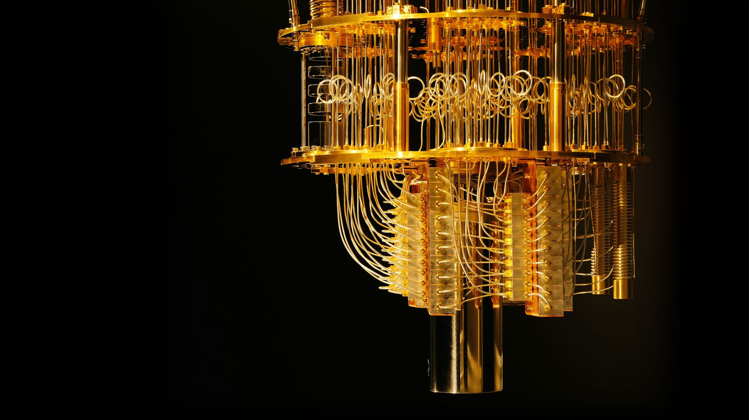
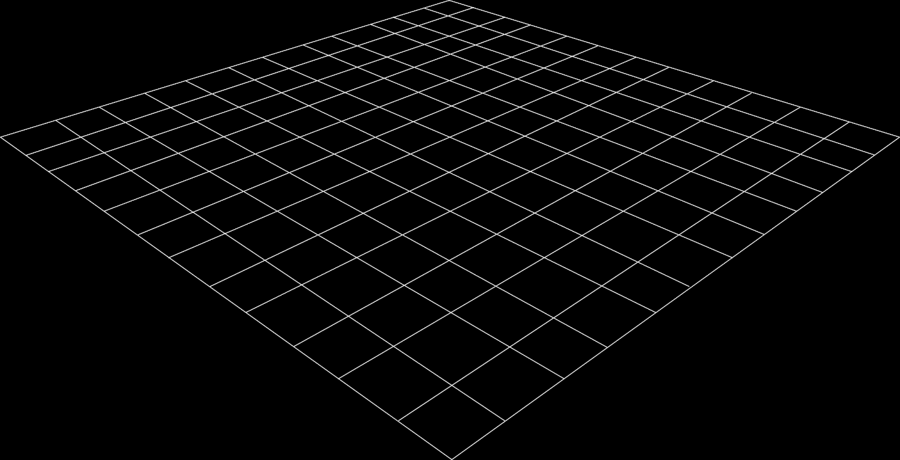
Quantum Mechanical Phenomena
3D Models
Superposition
Entanglement
Interference
Quantum computers leverage these phenomena to achieve exponential speedup, enabling them to tackle more challenging problems.
3D helps foster conceptual understanding and visual and spatial thinking.
Animated 3D models display objects within space in ways text and images cannot.
Quantum Cryostat >

Slide 3

Global Companies Investing In Quantum Computing

Slide 4
Quantum Computing SDKs
1. IBM Qiskit (Python)
2. Google Cirq (Python)
3. Microsoft Q# (C++)
4. Amazon Quantum (Python)
5. Xanadu Pennylane (Python)

Slide 5
So what can we do with quantum computers?

Slide 6
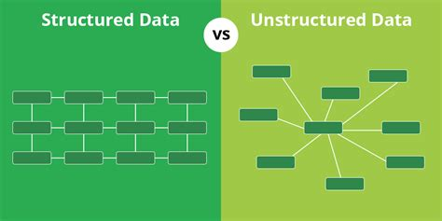
Searching Unstructured Database
Grover’s Algorithm developed by Lov Grover in 1996
Uses an oracle function that marks the solution state. The oracle flips the sign of the amplitude of the solution state
The process is iterated, and the solution determined
The algorithm reduces search times exponentially

Slide 7
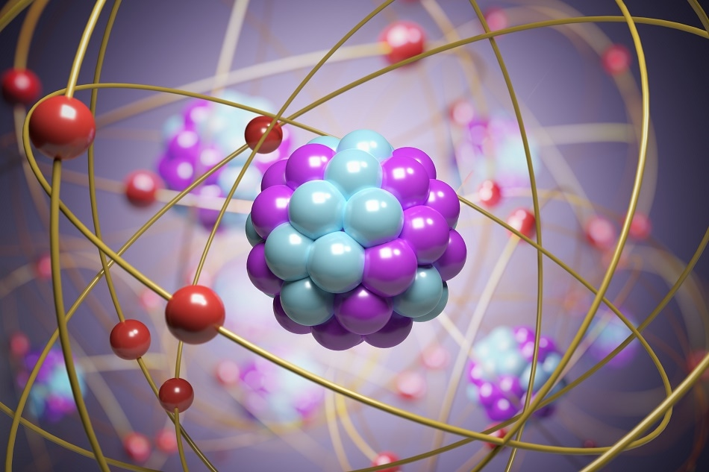
Quantum Chemistry
Quantum Mechanics determines optical, electrical, chemical properties of materials.
These properties can all be determined using the Schrödinger equation.
It is therefore ideal to use quantum computers to model and study these processes.

Slide 8

Quantum Machine Learning (QML)
1
This is an intersection field between quantum computing and machine learning.
2
Quantum Neural Networks
2
Quantum Annealing
2
Quantum Generative Models

Slide 9
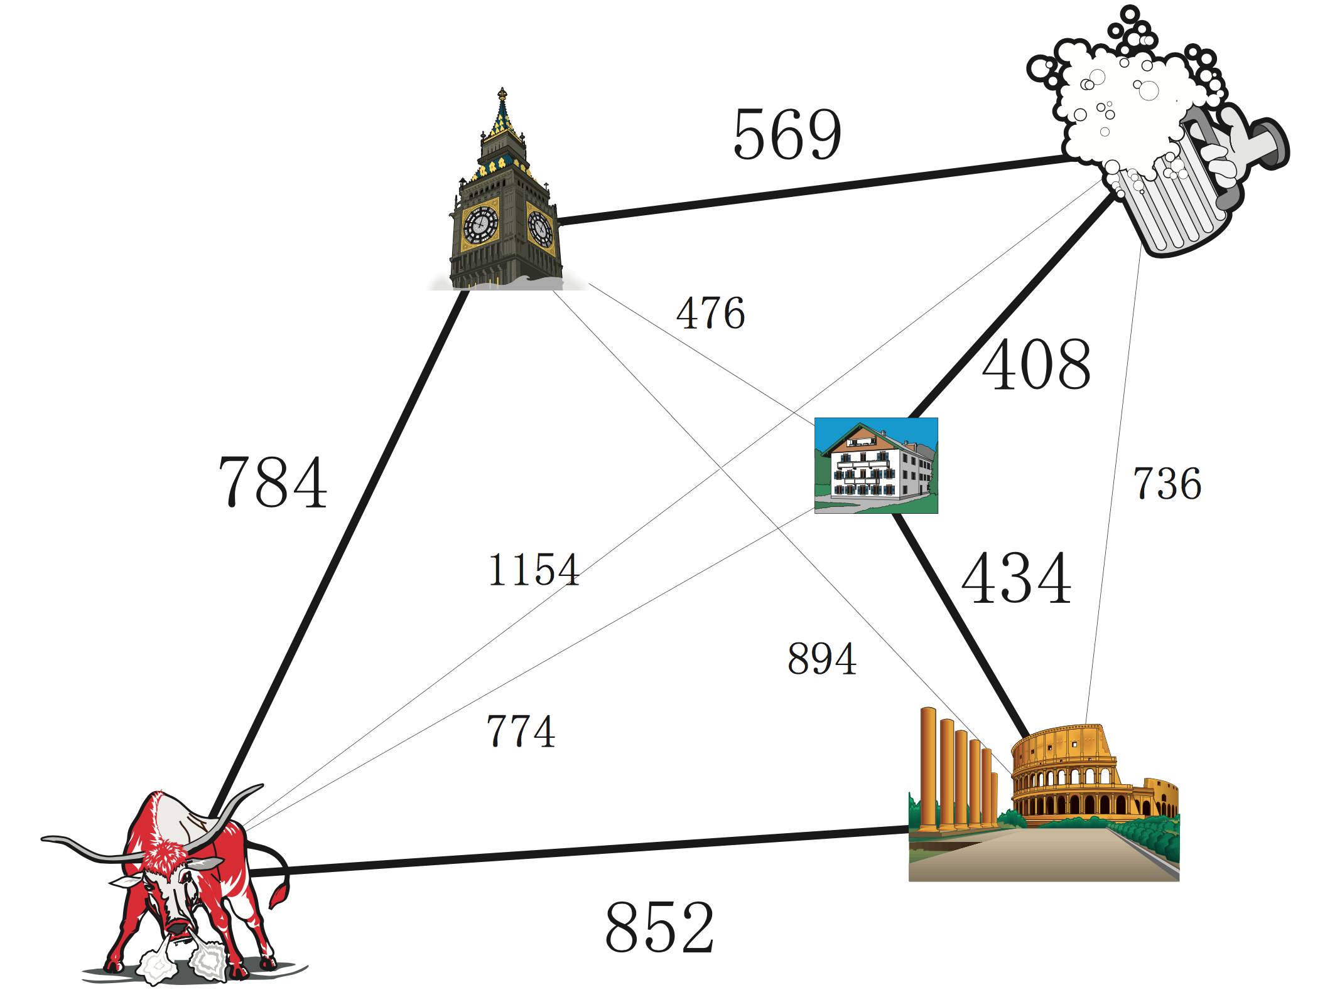
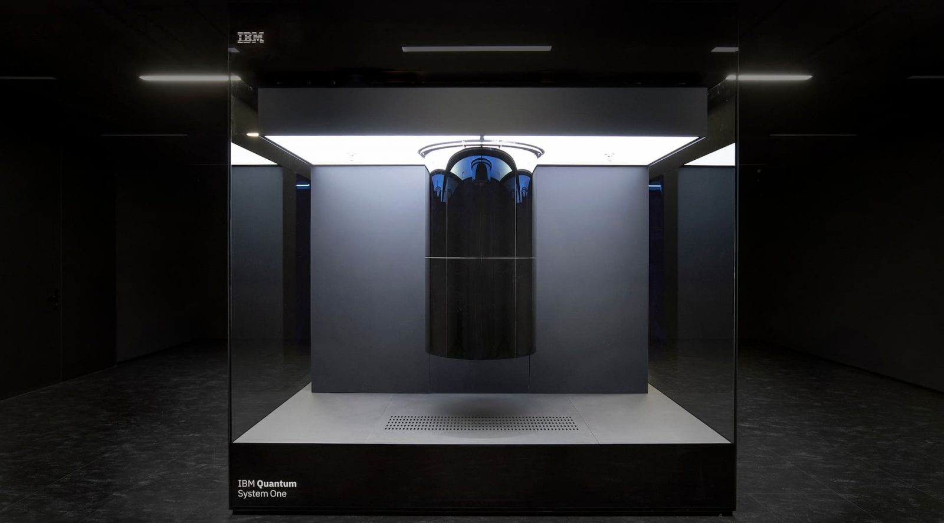

Many Other Application Areas
2
Logistics
1
Finance
3
Quantum Hardware

Slide 10





Thank you!
Aniekan Afangideh
Your neighbourhood Quantum Scientist

